Slide 1
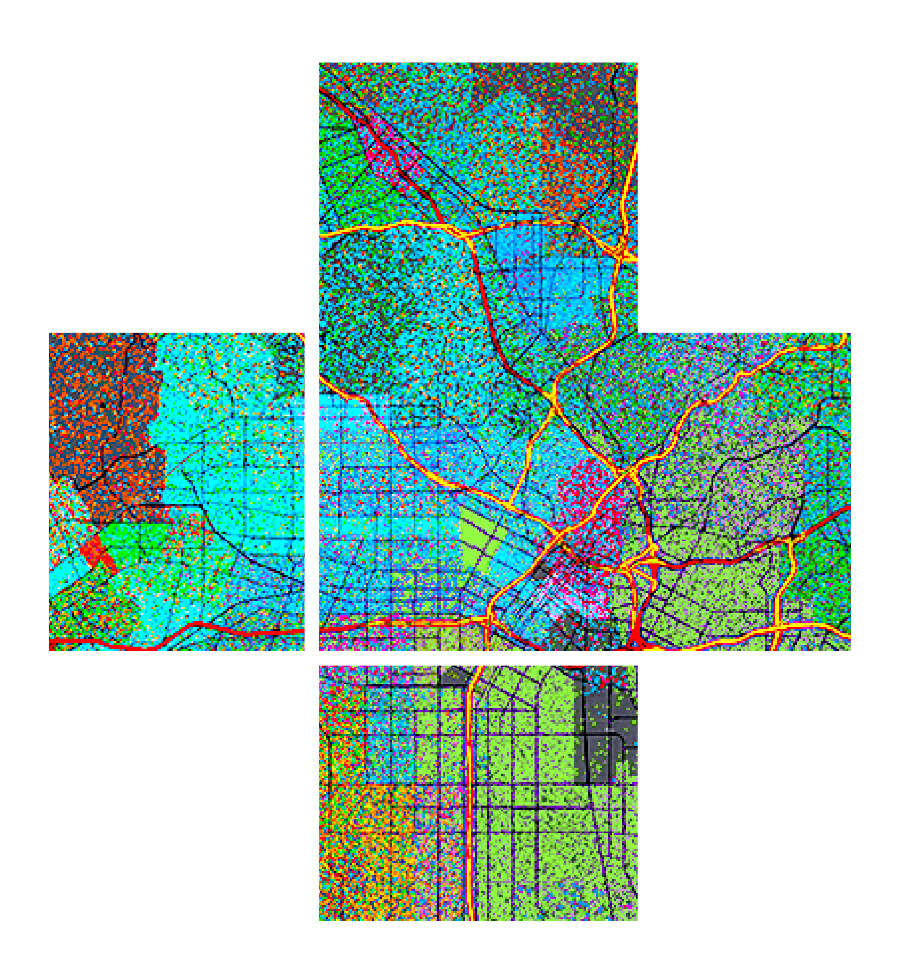








Practical Guide for Building a 3D Web App from 2D Data
Kristian Ekenes, Raluca Nicola
2020 ESRI DEVELOPER SUMMIT | Palm Springs, CA

Slide 2





Kristian Ekenes
Raluca Nicola
Product Engineer JS API
Product Engineer JS API
Data visualization, Smart Mapping, Arcade
Data visualization, 3D
Redlands, California
Zurich, Switzerland
Notes:
Not sure if this slide is worth it. We present ourselves anyway

Slide 3
You will learn…
Notes:
Motivation – why are they here

Slide 4
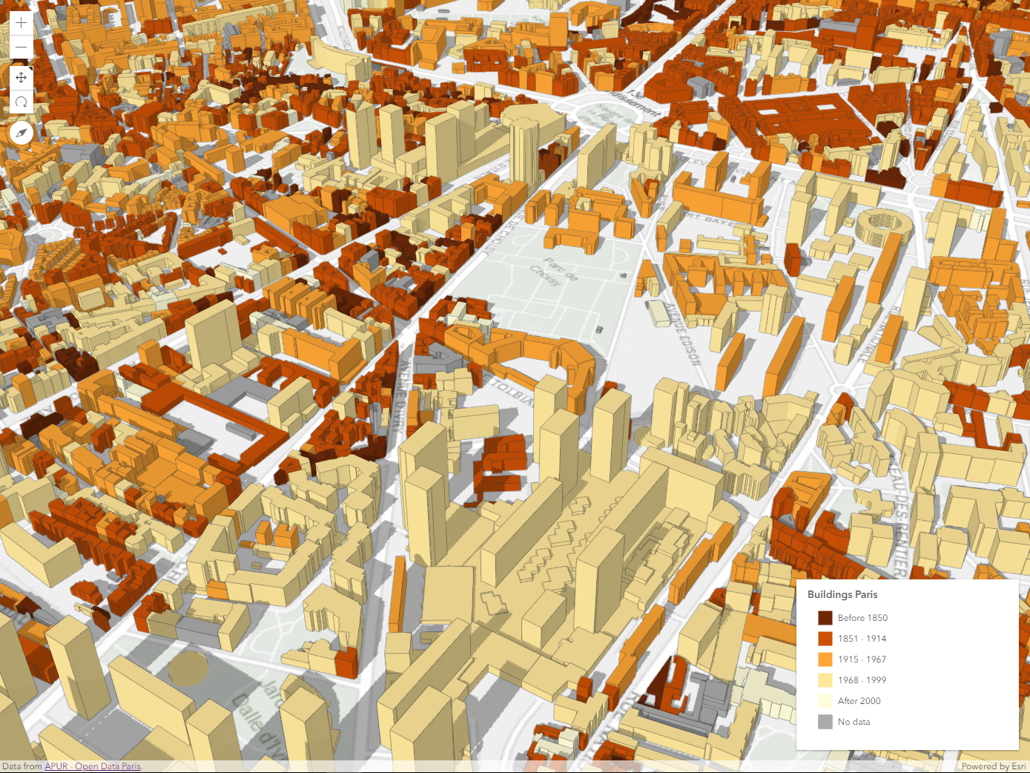
how to create city visualizations
using polygon extrusion and web styles
Notes:
Motivation – why are they here
They’ll learn how to visualize data like this

Slide 5
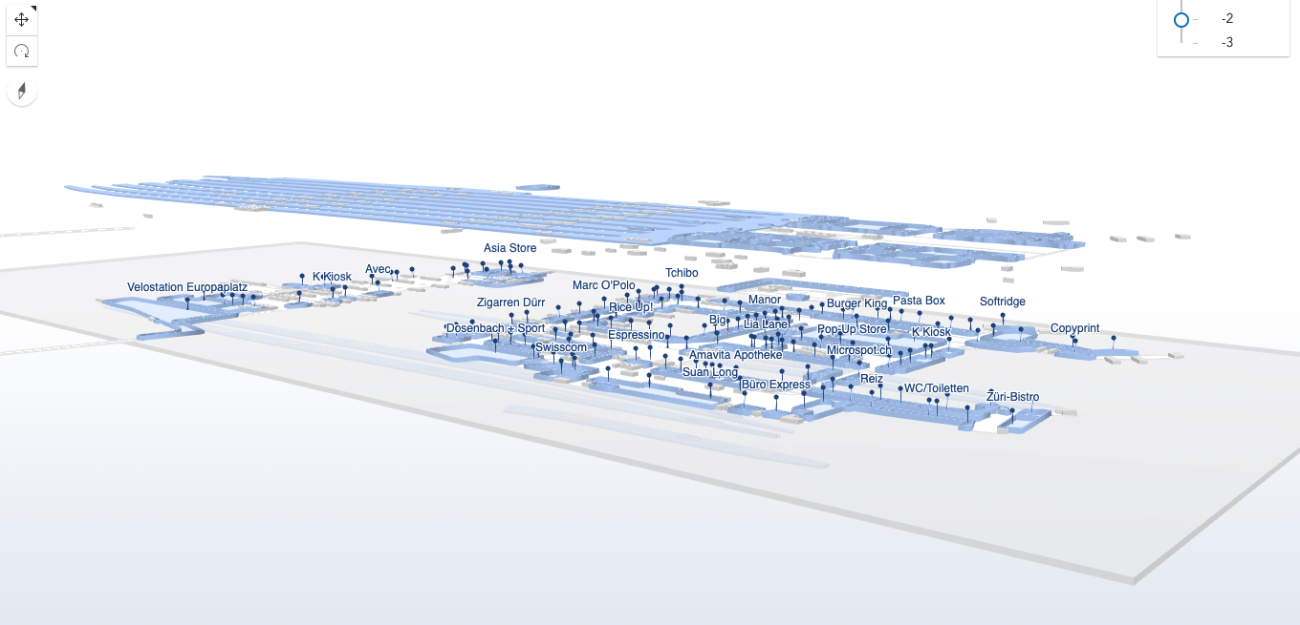
how to create a 3D train station plan
using elevation derived from attributes
Notes:
Motivation – why are they here
They’ll learn how to visualize data like this

Slide 6
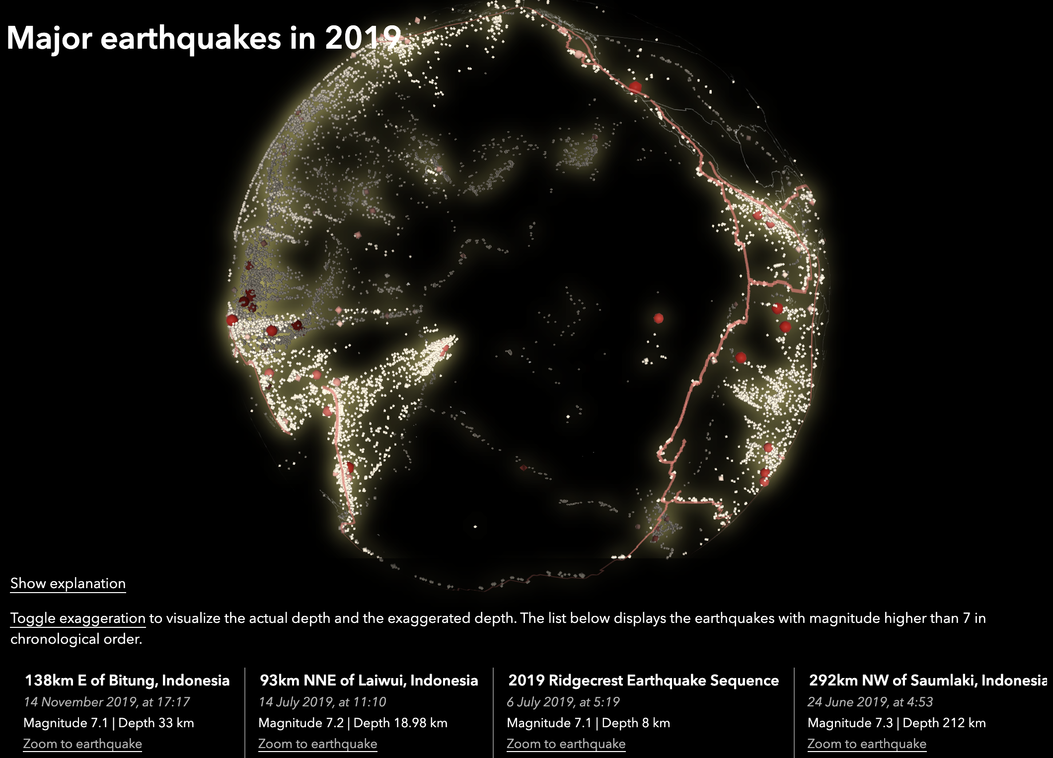
how to create a globe of earthquakes
using depth derived from attributes
Notes:
Motivation – why are they here
They’ll learn how to visualize data like this

Slide 7
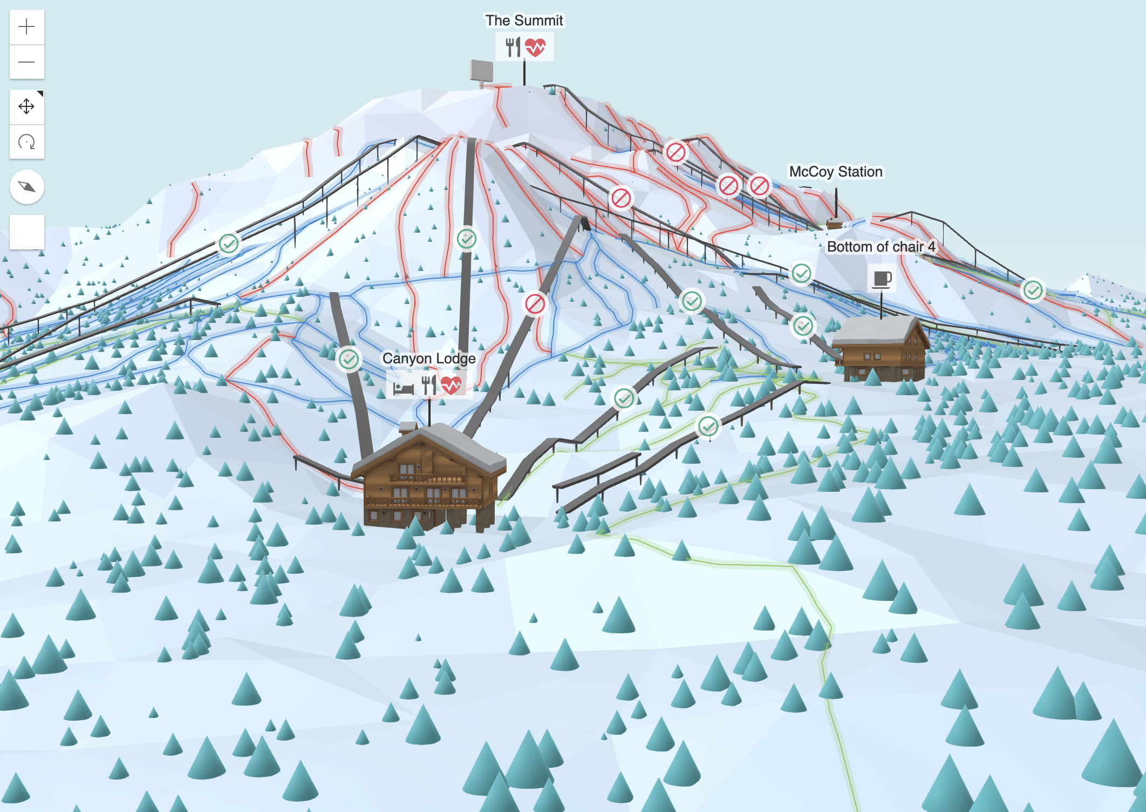
how to create a ski resort map
by deriving height from Esri’s elevation service
Notes:
Motivation – why are they here
They’ll learn how to visualize data like this

Slide 8
Other examples
and resources
City visualizations
Earthquake globe
10 min
10 min
10 min
10 min
10 min
Train station plan
Ski resort map

Slide 9
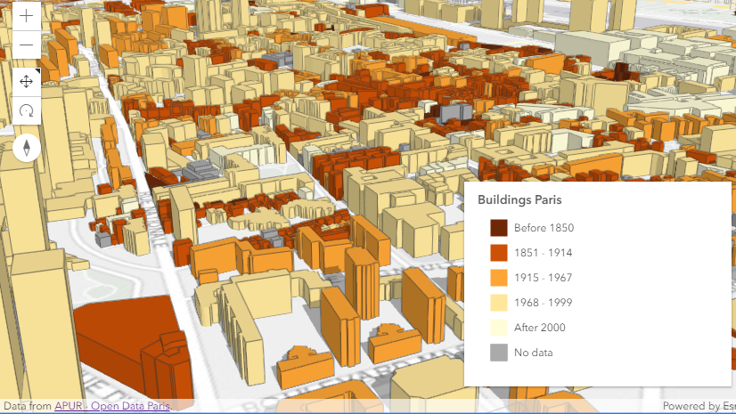
City visualizations
Building a city analysis app from building footprints

Slide 10
Resources
Open Data portals – building footprints
ESRI basemaps & elevation services
ESRI Web Styles
ArcGIS API for
JavaScript

Slide 11
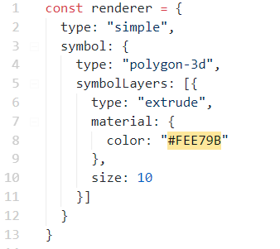



Building footprint extrusion
10 meters

Slide 12
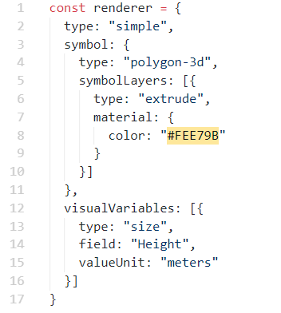
Building footprint extrusion
$feature.Height

Slide 13
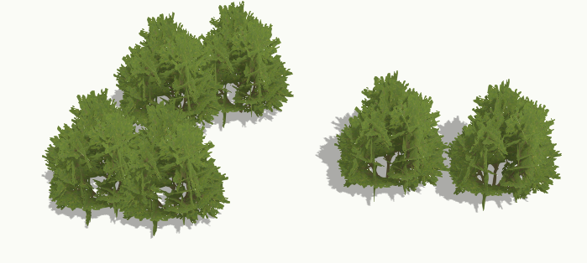
3D models – WebStyleSymbols

Slide 14
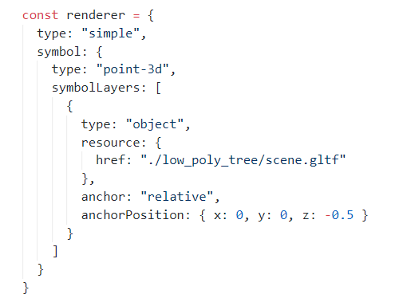

3D models - glTF

Slide 15
3D plan of a train station
Building it from GeoJSON data with floor attributes

Slide 16
Some explanations here

Slide 17
Earthquakes globe
Visualize earthquakes in 2019 with exaggerated depth on a globe

Slide 18
Some explanations here

Slide 19
Ski resort
Create a playful 3D visualization of a ski resort by deriving the height from the elevation service

Slide 20
Some explanations here

Slide 21
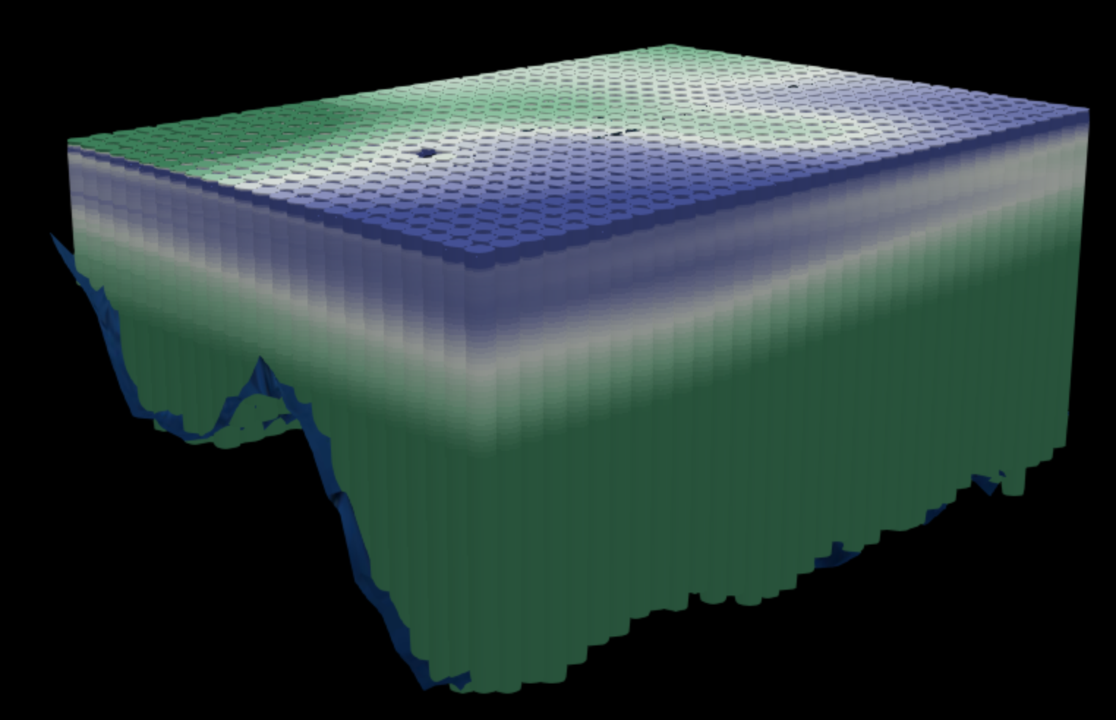
Marine data analysis

Slide 22

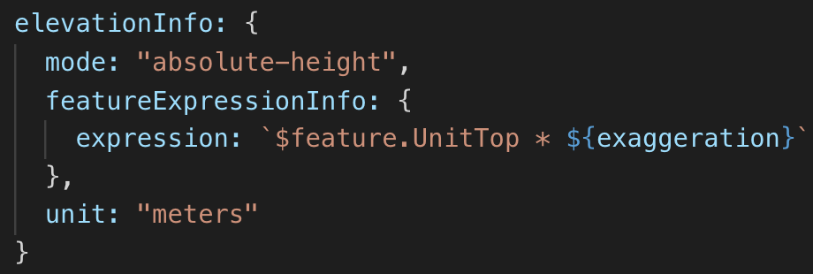
0
100

Slide 23
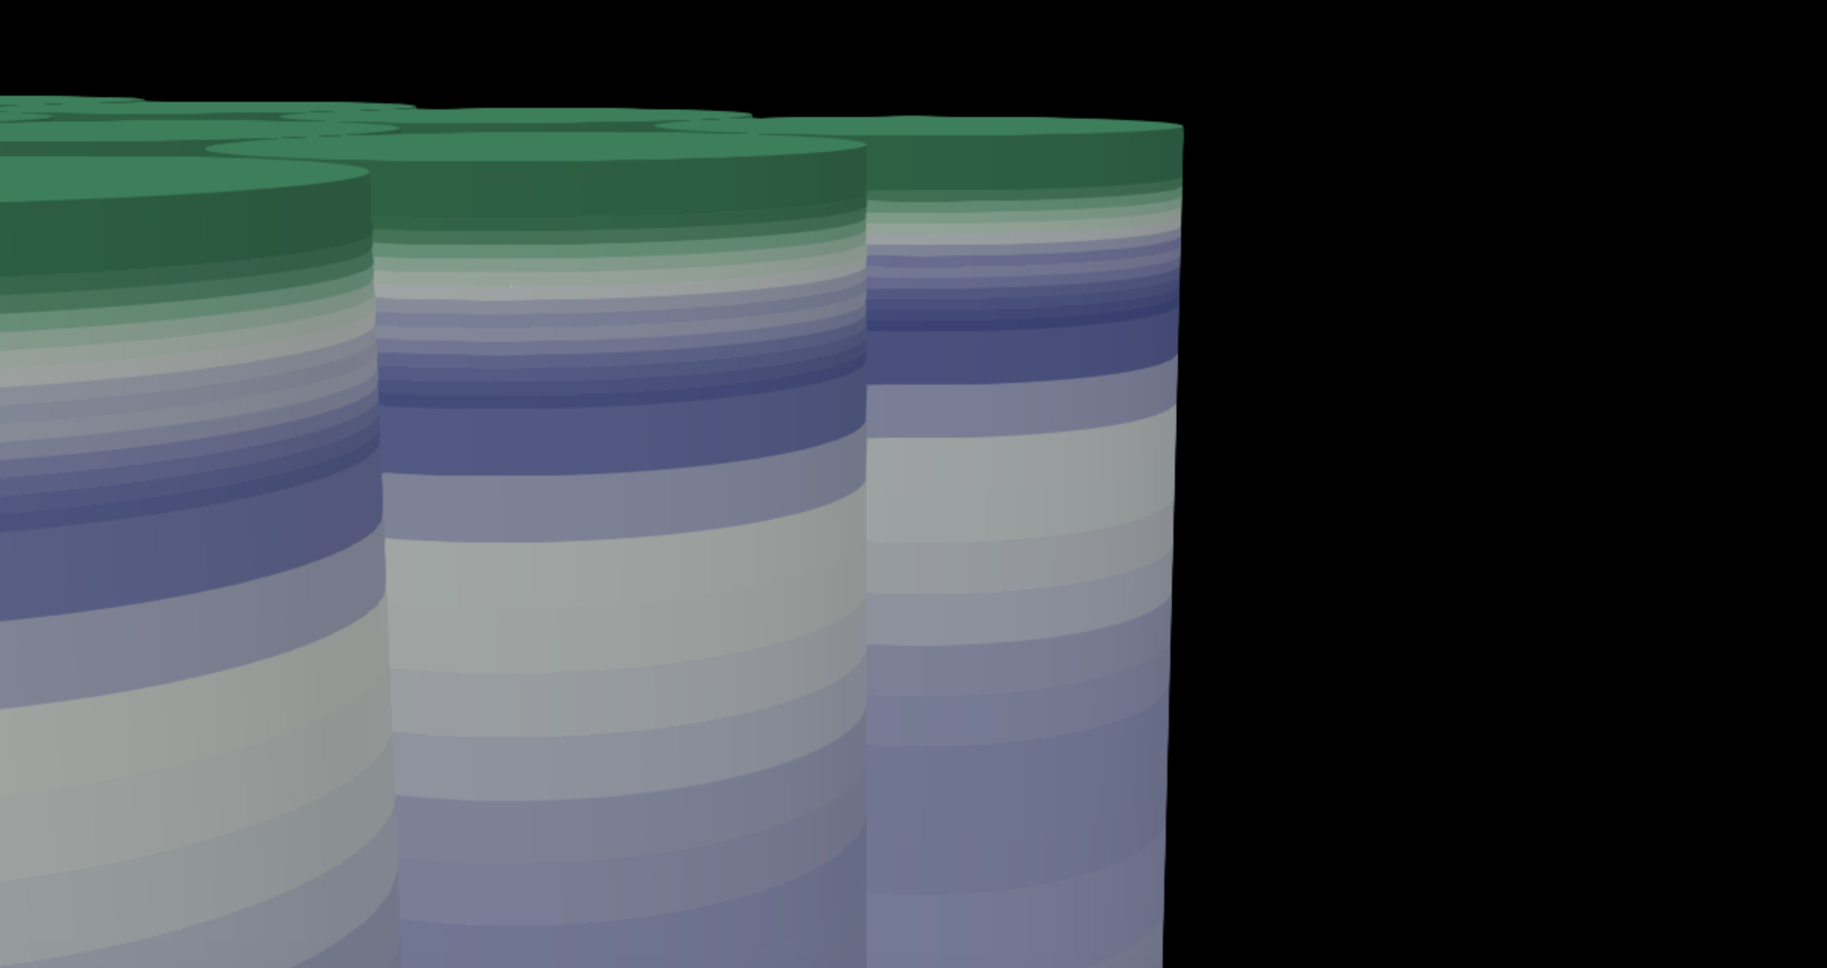
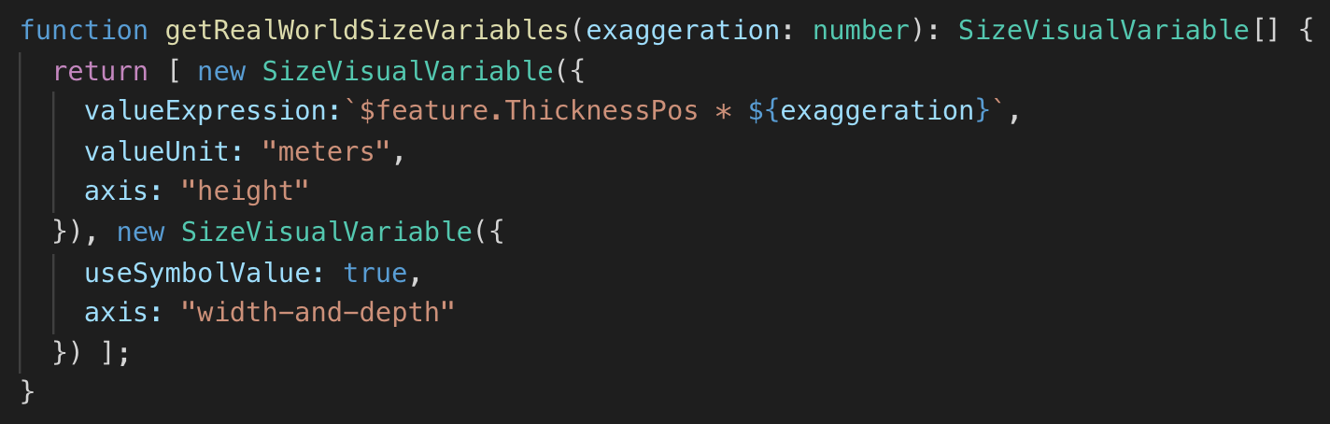

Slide 24
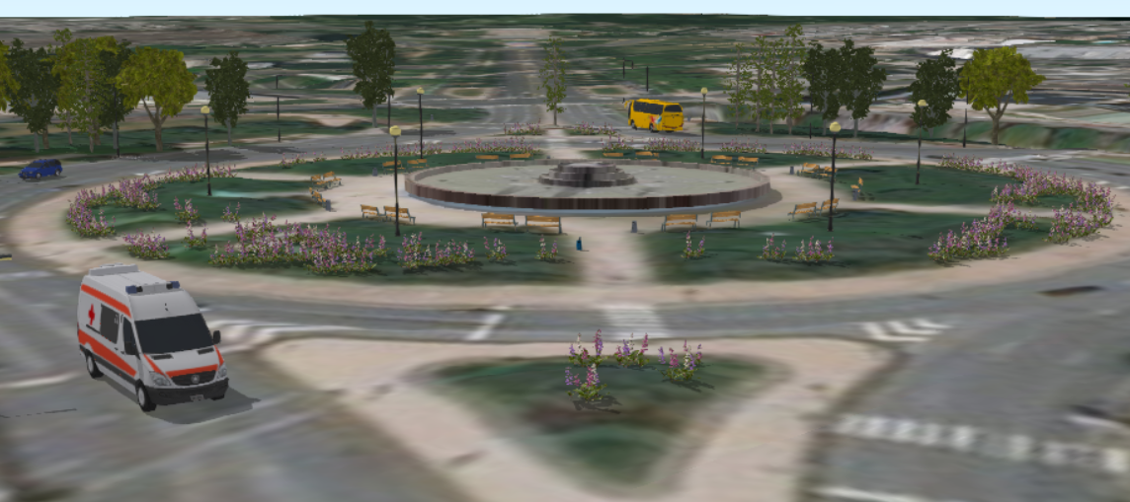
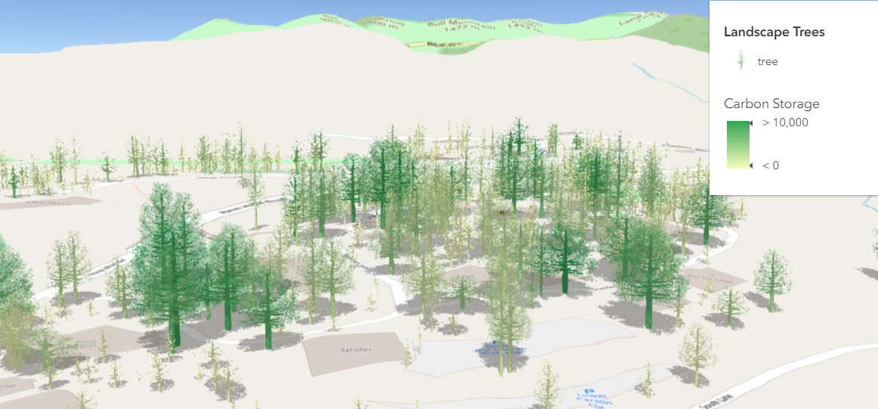
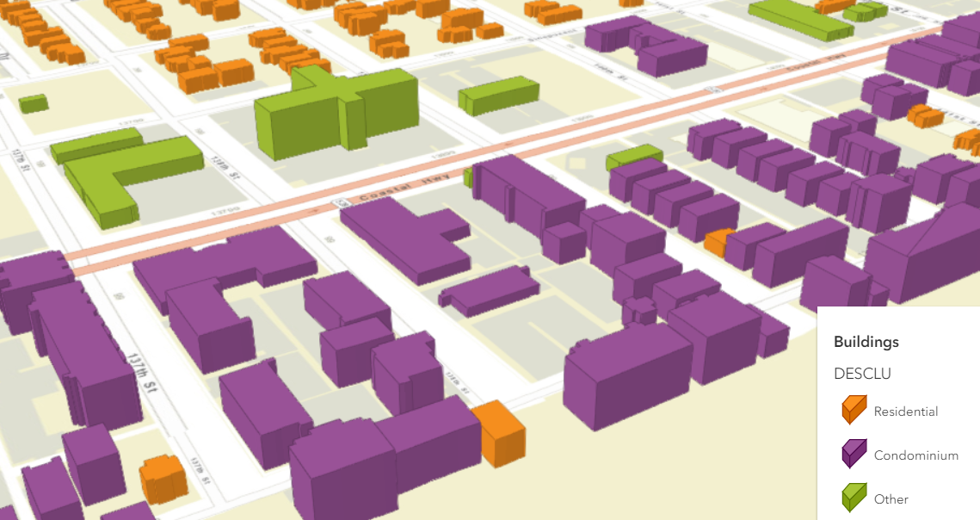
Documentation samples

Slide 25
More resources
ArcGIS API for JavaScript SDK samples:
https://developers.arcgis.com/javascript/latest/sample-code/index.html?search=webstyle
Making the leap to 3D - http://www.esri.com/esri-news/arcuser/fall-2017/making-the-leap-to-web-3d (ArcUser article)
Visualize large feature datasets in 3D with ArcGIS API for JavaScript - https://www.esri.com/arcgis-blog/products/js-api-arcgis/3d-gis/visualize-large-feature-datasets-in-3d-with-arcgis-api-for-javascript/

Slide 26


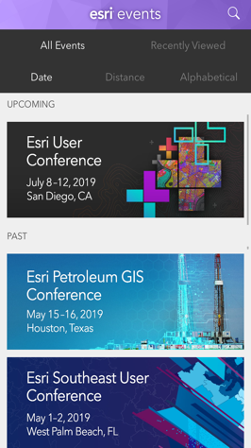
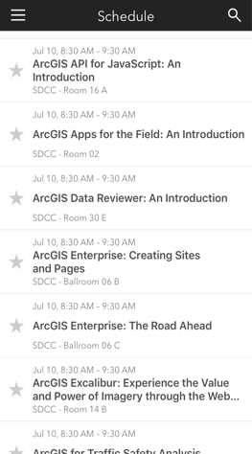

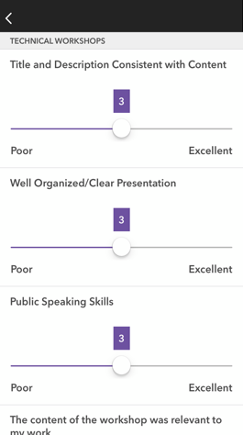




Please Share Your Feedback in the App
Download the Esri Events app and find your event
Select the session you attended
Scroll down to “Survey”
Log in to access the survey
Complete the survey and select “Submit”
Notes:
Guidance:
This is the survey slide. You can use the example as is or you can screenshot your session.

